Slide 1

HALİM AVCI Web Programing Final Project MSN Clone Web Site ID: 20070006009

Slide 2
Technologies I Used:
Django Python Framework for Backend
HTML/CSS/Bootstrap/JavaScript for Frontend
MySQL for database

Slide 3
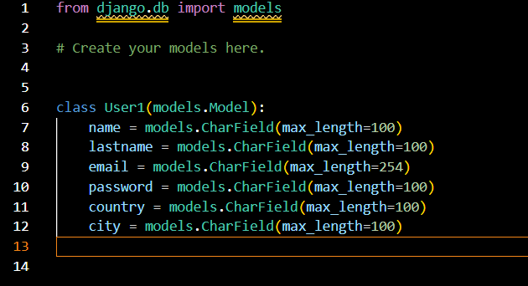
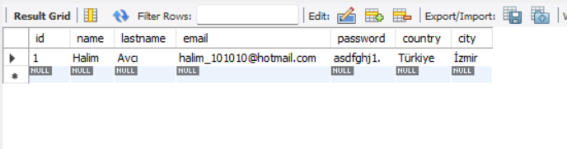
Database Structure:

